Slide 1
Introduction of
Data Structures and Algorithms

Slide 2
Definition
Data structure is representation of the logical relationship existing between individual elements of data.
In other words, a data structure is a way of organizing all data items that considers not only the elements stored but also their relationship to each other.
Data structure affects the design of both structural and functional aspects of a program.
Program= Algorithm + Data Structure

Slide 3
Introduction
Algorithm is a set of instruction written to carry out certain tasks & the data structure is the way of organizing the data with their logical relationship retained.
To develop a program of an algorithm, we should select an appropriate data structure for that algorithm.
Therefore algorithm and its associated data structures from a program.

Slide 4
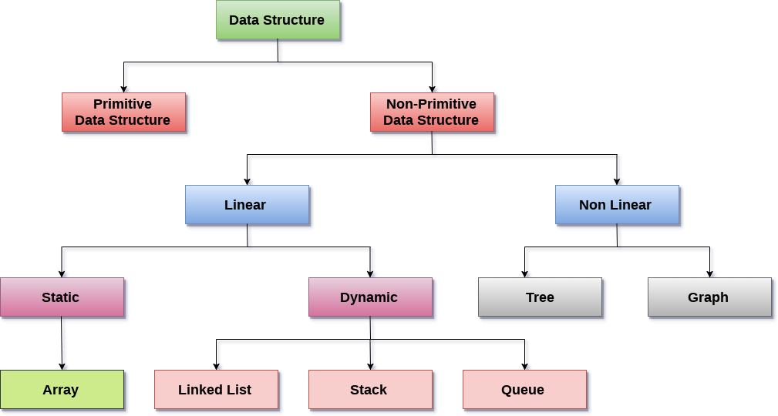
Classification of Data Structure

Slide 5
Primitive – Non Primitive
Primitive data structures are the fundamental data structures.
It can be operated directly on the data and machine instructions.
Primitive data structures are defined by the programming languages, or we can say that it is built-in.
Non-primitive data structures are the data structures that are created using the primitive data structures.
It is little bit complicated as it is derived from primitive data structures.
Some of Non-primitive data structures are linked lists, stacks, trees, and graphs.
Also we can say that is a grouping of same or different data items.

Slide 6
Data structures operations
The most commonly used operation on data structure are broadly categorized into following types:
  Create
  Selection
  Updating
  Searching
  Sorting
  Merging
  Delete

Slide 7
Data Structures : Arrays
An array is defined as a set of finite number of homogeneous elements or same data items.
It means an array can contain one type of data only, either all integer, all float-point number or all character.

Slide 8
Arrays
  Insertion of new element
  Deletion of required element
  Modification of an element
  Merging of arrays

Slide 9
Linked Lists
A lists (Linear linked list) can be defined as a collection of variable number of data items.
Lists are the most commonly used non-primitive data structures.
An element of list must contain at least two fields, one for storing data or information and other for storing address of next element.
As you know for storing address we have a special data structure of list the address must be pointer type.

Slide 10
Lists
Technically each such element is referred to as a node, therefore a list can be defined as a collection of nodes as show bellow:
[Linear Liked List]
Head
AAA
BBB
CCC
Information field
Pointer field

Slide 11
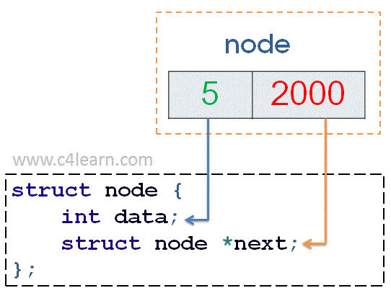
Node Structure

Slide 12
Stack
A stack is also an ordered collection of elements like arrays, but it has a special feature that deletion and insertion of elements can be done only from one end called the top of the stack (TOP)
Due to this property it is also called as last in first out type of data structure (LIFO).

Slide 13
Stack
Insertion of element into stack is called PUSH and deletion of element from stack is called POP.
The bellow show figure how the operations take place on a stack:
PUSH
POP
[STACK]

Slide 14
Stack
The stack can be implemented into two ways:
  Using arrays (Static implementation)
  Using pointer (Dynamic implementation)

Slide 15
Queue
Queue are first in first out type of data structure (i.e. FIFO)
In a queue new elements are added to the queue from one end called REAR end and the element are always removed from other end called the FRONT end.
The people standing in a railway reservation row are an example of queue.

Slide 16
Queue
Each new person comes and stands at the end of the row and person getting their reservation confirmed get out of the row from the front end.
The bellow show figure how the operations take place on a queue:
10 | 20 | 30 | 40 | 50
front
rear

Slide 17
Queue
The queue can be implemented into two ways:
  Using arrays (Static implementation)
  Using pointer (Dynamic implementation)

Slide 18
Trees
The tree is a nonlinear hierarchical data structure and comprises a collection of entities known as nodes. It connects each node in the tree data structure using "edges”, both directed and undirected.
There is a special data item at the top of hierarchy called the Root of the tree.
The remaining data items are partitioned into number of mutually exclusive subset, each of which is itself, a tree which is called the sub tree.
The tree always grows in length towards bottom in data structures, unlike natural trees which grows upwards.

Slide 19
Trees
The tree structure organizes the data into branches, which related the information.
A
root
B
C
D
E
F
G

Slide 20
Graph
Graph is a non-linear data structure capable of representing many kind of physical structures.
It has found application in Geography, Chemistry and Engineering sciences.
Definition: A graph G(V,E) is a set of vertices V and a set of edges E.
An edge connects a pair of vertices and many have weight such as length, cost and another measuring instrument for according the graph.
Vertices on the graph are shown as point or circles and edges are drawn as arcs or line segment.

Slide 21
Graph
Example of graph:
6
v2
v5
v1
v3
10
v1
8
11
15
9
v2
v3
v4
v4
v4
[a] Directed & Weighted Graph
[b] Undirected Graph

Slide 22
Graph
Types of Graphs:
  Directed graph
  Undirected graph
  Weighted graph
  Connected graph
  Non-connected graph

Slide 23
Real-life applications
You have to store social network “feeds”. You do not know the size, and things may need to be dynamically added.
You need to store undo/redo operations in a word processor.
You need to evaluate an expression.
You need to store the friendship information on a social networking site. i.e., who is friends with who.
You need to store an image (1000 by 1000 pixels) as a bitmap.

Slide 24
To implement printer spooler so that jobs can be printed in the order of their arrival.
To implement back functionality in the internet browser.
To store the possible moves in a chess game.
To store a set of ﬁxed key words which are referenced very frequently.
To store the customer order information in a drive-in burger place. (Customers keep on coming and they have to get their correct food at the payment/food collection window.)
To store the genealogy information of biological species.

